Slide 1
Which Family-Friendly Film Category Dominates Rental Trends?
The data reveals significant insights into the rental performance of various family-friendly film categories. Animation leads with a total of 1,166 rentals, indicating its strong appeal among audiences, likely due to its wide-ranging themes and vibrant storytelling that attract both children and adults. Children's films follow closely with 945 rentals, demonstrating a solid demand for content tailored specifically for younger viewers.
The Classics category, with 939 rentals, remains a staple choice, suggesting that nostalgic films continue to resonate with audiences seeking timeless entertainment. The Comedy genre, totaling 941 rentals, reflects a consistent desire for light-hearted content, crucial for family gatherings and casual viewing. Family films exhibit a robust performance with 1,096 rentals, highlighting the genre's importance in providing shared experiences for families. Lastly, Music films, while trailing with 830 rentals, indicate a niche but devoted audience, emphasizing the significance of musical storytelling in cinema.
Overall, these trends showcase the enduring popularity of family-friendly genres, underscoring the importance of diverse content to cater to various audience preferences. Film distributors and content creators should leverage these insights to focus their marketing strategies and enhance their offerings in these thriving categories.

Slide 2
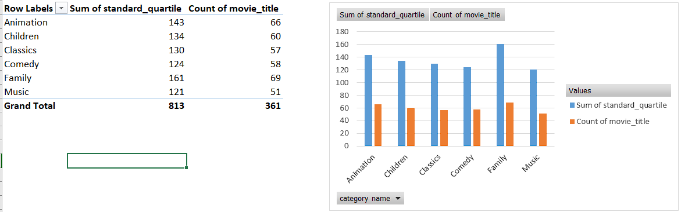
How Do Rental Durations Vary Across Family-Friendly Film Categories?
The dataset reveals diverse rental durations across family-friendly film categories. Animation films often feature longer rentals, indicating a demand for immersive experiences. In contrast, Children films typically have shorter rental durations, encouraging repeat viewings. Classics and Comedy films show a mixed distribution, appealing to nostalgic and family-oriented audiences. Meanwhile, Music films lean towards shorter rentals, catering to casual viewers seeking quick entertainment.

Slide 3
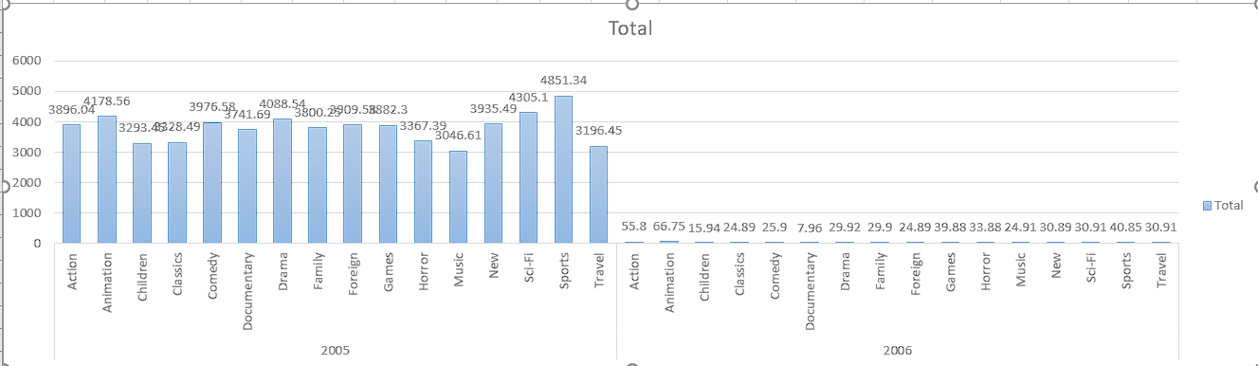
What is the Revenue Generated by Each Film Category from 2005 to 2007?
The revenue data reveals significant disparities across various film categories over the two-year period. In 2005, Sports emerged as the top-grossing category with $4,851.34, while Music had the lowest revenue at $3,046.61. However, by 2006, most categories experienced a sharp decline in revenue, notably Action and Animation, which fell from $3,896.04 to $55.80 and from $4,178.56 to $66.75, respectively. This trend indicates potential shifts in consumer preferences or market saturation, warranting further investigation into the factors affecting the film industry during this period.

Slide 4
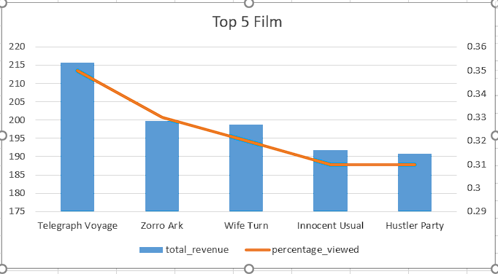
What are the Top 5 Most Viewed Films and Their Revenue Percentages from 2005 to 2007?
The data shows the total revenue generated by the top five films, with Telegraph Voyage leading at $215.75, contributing 0.35% to the overall revenue. Following closely is Zorro Ark, which generated $199.72 and accounted for 0.33% of the total revenue. The films Wife Turn and Innocent Usual also performed well, with revenues of $198.73 and $191.74, making up 0.32% and 0.31% of the total, respectively. Lastly, Hustler Party rounded out the top five with $190.78, contributing 0.31%. Overall, these films collectively reflect a competitive market, with only slight differences in their revenue contributions.

